Slide 1
The Complement System FACTS & UPDATES
Rally R. Rutaquio, RMT, RPT, CLS, ASCPi

Slide 2
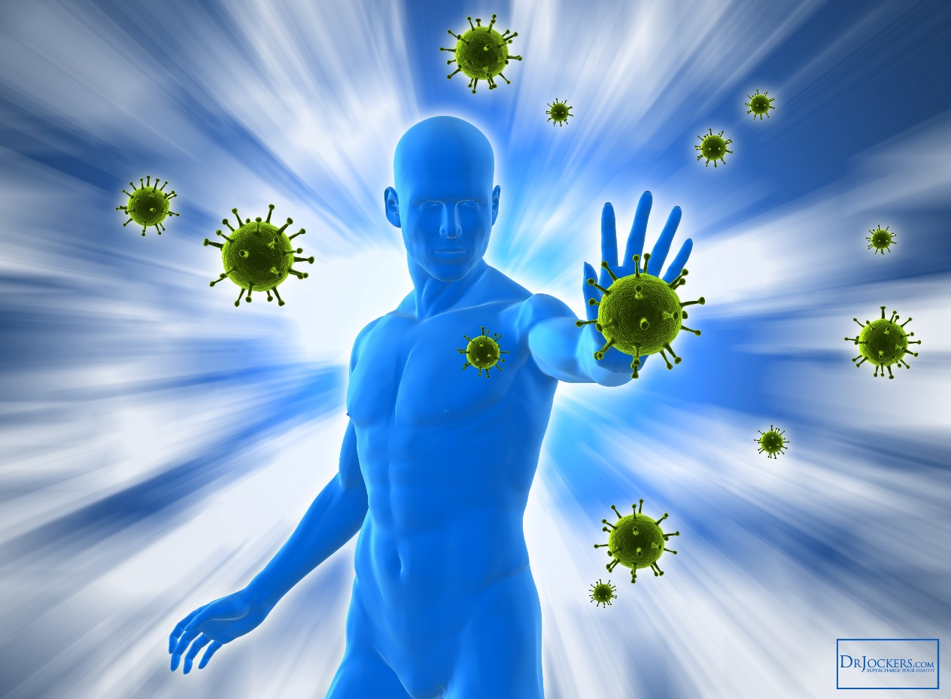
Overview of the Immune System
Immunology
Immunity
Immune System

Slide 3
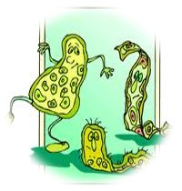
Overview of the Immune System

Slide 4
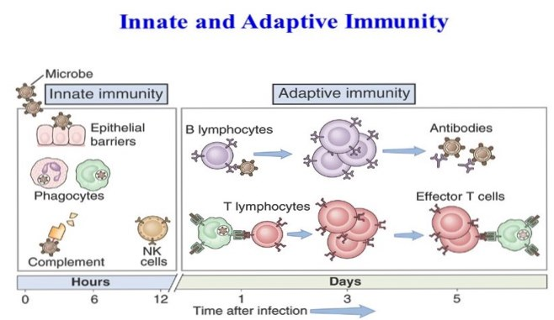
Types of Immunity
Innate
2. Adaptive

Slide 5
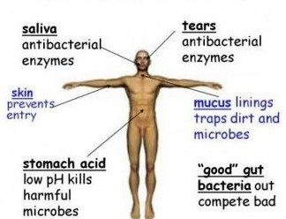
Types of Immunity
Innate
Non specific
No memory
Minutes to hours
Same each time

Slide 6
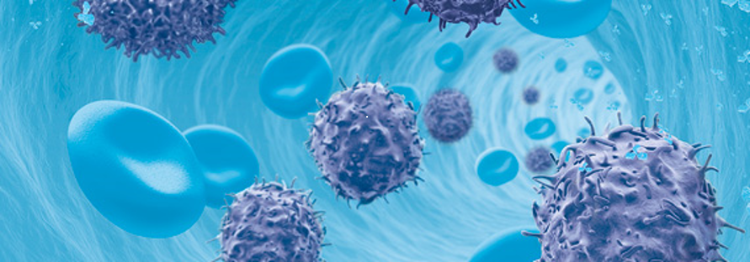
Types of Immunity
Adaptive
Specific
Memory
Days
More rapid

Slide 7
The Complement System
a set of 50-plus serum proteins
important for the effective operation of both the innate and adaptive branches of the immune system
must be activated before it can function

Slide 8
Biological Functions

Slide 9
Biological Functions
Other functions:
Disposal of immune complexes
Disposal of apoptotic cells and bodies

Slide 10
Four Main Pathways of Activation
1. Classical
2. Lectin
3. Alternative
4. Terminal

Slide 11
Key Components
1. Classical- Antibody Dependent
-IgM, IgG
-C1,C2,C3,C4
-C4b2a as C3 convertase
-C4b2a3b as C5 convertase

Slide 12
Key Components
2. Lectin
-MBL or Ficolins
-MASP-1, MASP-2
-C2, C3, C4
-C4b2a as C3 convertase
-C4b2a3b as C5 convertase

Slide 13
Key Components
3. Alternative
-C3
-Factor B, Factor D
-Properdin
-C3bBb as C3 convertase
-C3bBb3b as C5 convertase

Slide 14
Key Components
4. Terminal
-C5
-C6
-C7
-C8
-C9

Slide 15
Key Components
C3-major complement
-common pathway
C5-common pathway

Slide 16
Activation of Complement

Slide 17
Classical Pathway

Slide 18
Alternative Pathway

Slide 19
Lectin Pathway

Slide 20
Terminal Pathway

Slide 21
Complement Cascade Review

Slide 22
Regulation
A. Passive
B. Active
1. C1 Inhibitor
2. DAF
3. Factor I
4. CD 59
5. Carboxypeptidases

Slide 23
Complement Deficiencies
C3 | Severe pyogenic infections and SLE
C1, C4, or C2 | Pyogenic infections and SLE
Properdin, Factor B, D | Severe pyogenic infections
Mannose Binding Lectin | Recurrent bacterial infections
C5, C6, C7, C8, C9 | Recurrent Neisserial (Gram-) infections

Slide 24
Complement Deficiencies
C1 inhibitor (C1 INH) | Angiodema
CD59, DAF | PNH
Factor H, I | Glomerulonephritis, HUS
Variations in Factor H | Age-related macular degeneration
CR3 | Recurrent bacterial infections

Slide 25
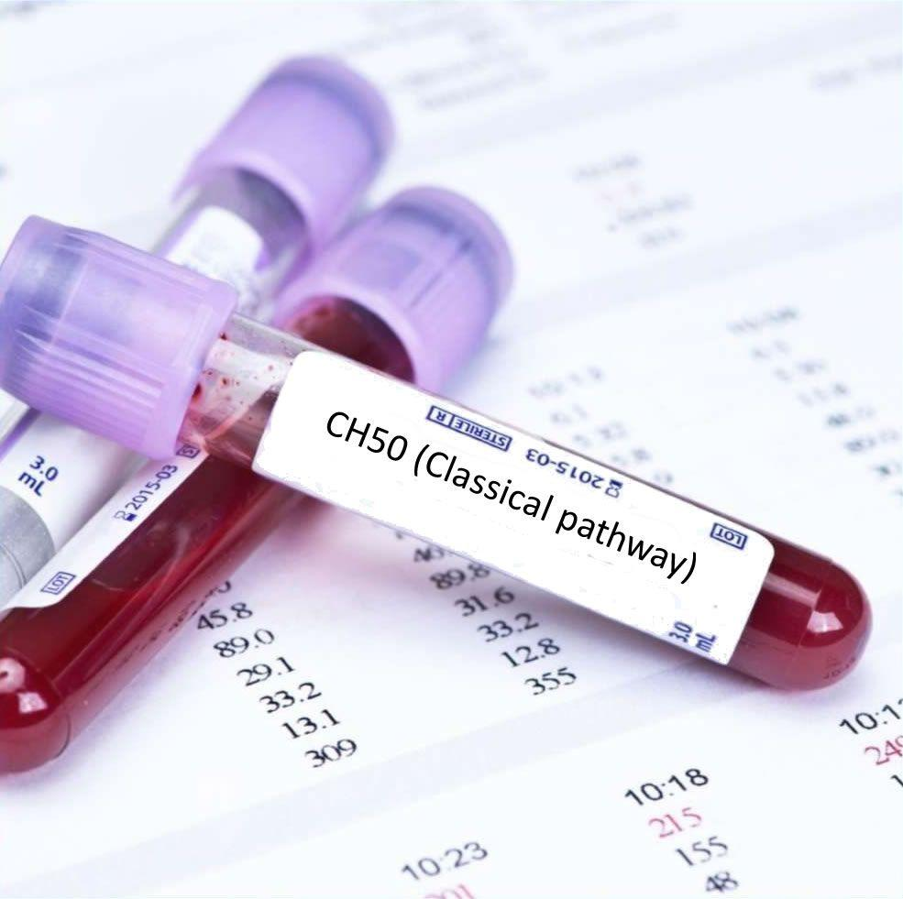
Complement Measurement
Functional Assessment
a. THC or CH50

Slide 26
Complement Measurement
Functional Assessment
b. AH50

Slide 27
Complement Measurement
2. Antigenic Assays
a. Immunoassays for C3 and C4 levels

Slide 28
Updates
Complement as a Therapeutic Target:
Eculizumab
Compstatin
POT-4
AMY-101

Slide 29
References
Punt, Stranford, Jones, Owen (2018). kuby immunology. New York, NY: W. H. Freeman and Company
Barnum, Schein (2018). the complement facts book. Academic Press An Imprint of Elsevier
Coico, Sunshine (2015). immunology: a short course. West Sussex, UK: John Wiley & Sons Ltd.
Sompayrac (2015). how the immune system works. Wiley-Blackwell
Lintner, Wu, Yang, Spencer, Yu, Hauptmann, Hebert, Atkinson (2016). frontiers of immunology. Article, Literature review

